Slide 1

Bachelor’s Thesis Computer Science Probabilistic Short-term Wind Power Forecasting
Johannes Gaus
18.07.2022

Slide 2
Contents
01 Introduction
02 Research Question
03 Approach
04 Results
05 conclusion

Slide 3
01 Introduction
Why bother with wind power forecasting?
to plan and operate a wind power farm
big shift to renewable energy sources and cope with the shortage of traditional fossil energy and the environmental pollution
successful integration of large amounts of wind power into the electricity supply system

Slide 4
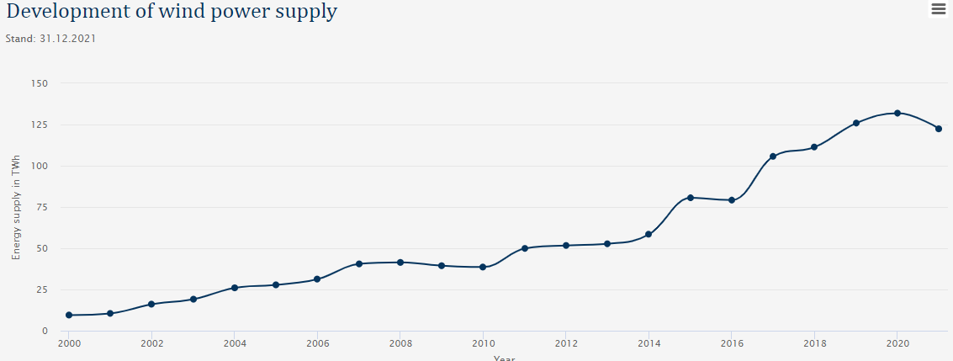
https://www.wind-energie.de/english/statistics/statistics-germany/

Slide 5

02 Research Question

Slide 6
Research Question
How to make a wind power forecasting model?
What is a good approach?
Multiple Linear Regression
Support Vector Regression
Which model works better with the dataset?

Slide 7
Approach Breakdown
Tian, Zhongda (2021). “A state-of-the-art review on wind power deterministic prediction”.
physical, statistical, and hybrid models
further divide statistical models into three categories:
time series approaches
ensemble prediction approaches
artificial intelligence approaches
artificial intelligence model with a supervised machine learning approach
Multiple Linear Regression
Support Vector Regression

Slide 8
Some literature
Tawn, R. and J. Browell (2022). “A review of very short-term wind and solar power forecasting”. In: Renewable and Sustainable Energy Reviews 153, doi: 10.1016/j.rser.2021.111758.
Tian, Zhongda (2021). “A state-of-the-art review on wind power deterministic prediction”. In: Wind Engineering 45.5 doi: 10. 1177/0309524X20941203.
Wang, Xiaochen, Peng Guo, and Xiaobin Huang (2011). “A Review of Wind Power Forecasting Models”. In: Energy Procedia 12, pp. 770–778. issn: 18766102. doi: 10.1016/j.egypro.2011.10.103.

Slide 9

03 Approach

Slide 10
03 Theoretical Approach
- What is Multiple Linear Regression
- What is Support Vector Regression
- What is an Evaluation Score

Slide 11
Multiple Linear Regression
statistical technique that uses two or more independent variables to predict the outcome of a dependent variable.
Linear least squares (LLS) is the least-squares approximation of linear functions to data
Maximum Likelihood estimation

Slide 12
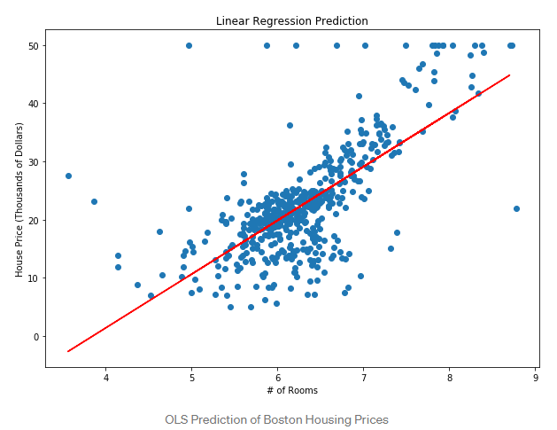
https://towardsdatascience.com/an-introduction-to-support-vector-regression-svr-a3ebc1672c2

Slide 13
Support Vector Regression
SVM ⇒ Classification
SVR for working with continuous Values instead of Classification
In simple linear regression, we try to minimize the error rate. In SVR, we try to fit the error within a certain threshold.

Slide 14
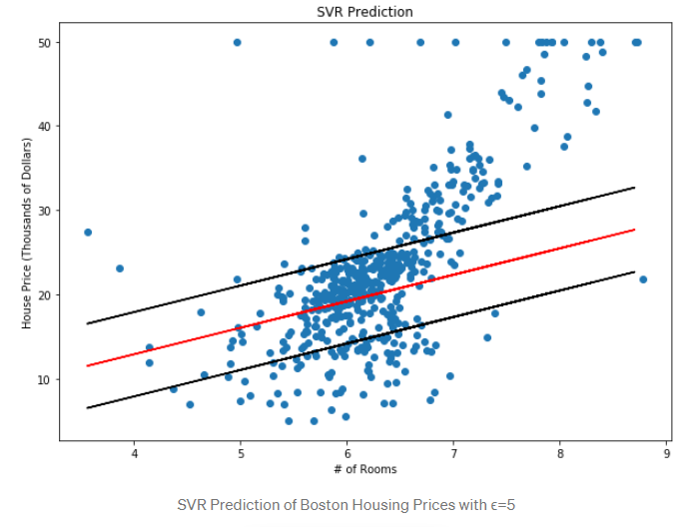
SVR
margin w+ε
ε
hyperplane w
margin w-ε
ξ
Slack variable ξ

Slide 15
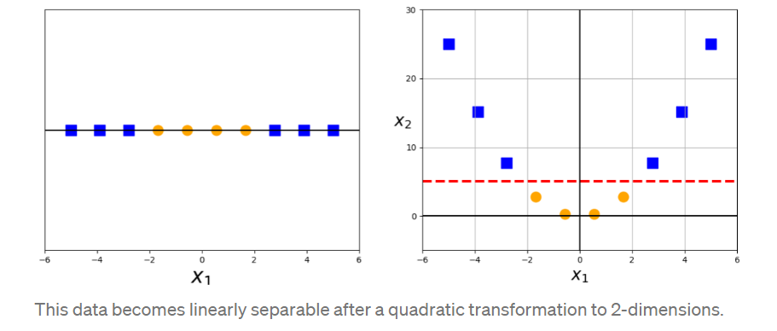
The kernel trick
- Smola, Alex J. and Bernhard Schölkopf (2004). “A tutorial on support vector regression”. In: Statistics and Computing 14.3, doi: 10.1023/B:STCO.0000035301.49549.88
https://towardsdatascience.com/the-kernel-trick-c98cdbcaeb3f

Slide 16
Support Vector Regression
We can choose how tolerant we are of errors, through an acceptable error margin(ϵ) and by tuning our tolerance of falling outside that acceptable error rate
we can map linear data into a higher feature space to get a better regression curve for the SVR algorithm
RBF Kernel
Linear Kernel
Poly Kernel
…

Slide 17
Evaluation Scores
MAE ⇒ mean absolute error
RMSE ⇒ root mean squared error
R2 ⇒ how well the data fit the regression model (the goodness of fit)
CRPS ⇒ comparison of the predicted cumulative density function (CDF) and the true cumulative density function
Shapley Values ⇒ attempt to explain why an ML model reports the outputs that it does on an input

Slide 18
03 Practical Approach
Cleaning the dataset
Feature selection
Multiple Linear Regression model Support Vector Regression model parameter and kernel selection

Slide 19

dataset
La haute borne windfarm in France
about 150 km to the left of Strasbourg
4 turbines
Data from 2016-12-31 until 2018-01-12
https://opendata-renewables.engie.com/explore/dataset/01c55756-5cd6-4f60-9f63-2d771bb25a1a/information
https://www.thewindpower.net/windfarm_en_3354_la-haute-borne.php

Slide 20
Feature Selection
Algorithm
recursive feature elimination algorithm
select k-Best algorithm
tried some features by hand
evaluate the different features using
Multiple Linear Regression model
MAE score, RMSE score, CRPS, and R2 score a

Slide 21
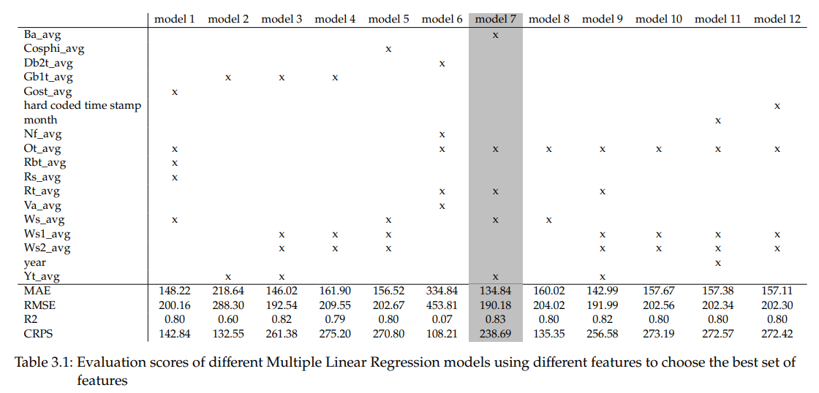
Feature Selection

Slide 22
Feature Selection
- the pitch angle (BA)
the hub temperature (Rt)
the nacelle temperature (Yt)
the wind speed (Ws)
the outdoor temperature (Ot)

Slide 23
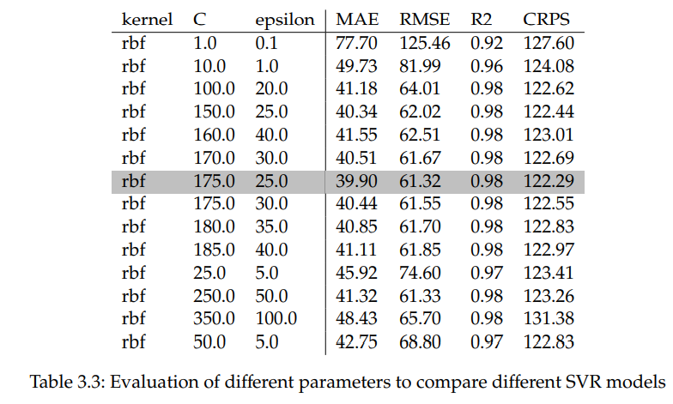
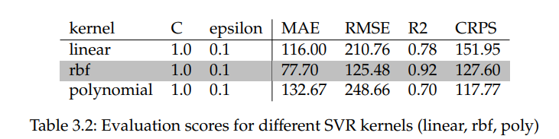
Parameter and Kernel Selection

Slide 24
04 results

Slide 25
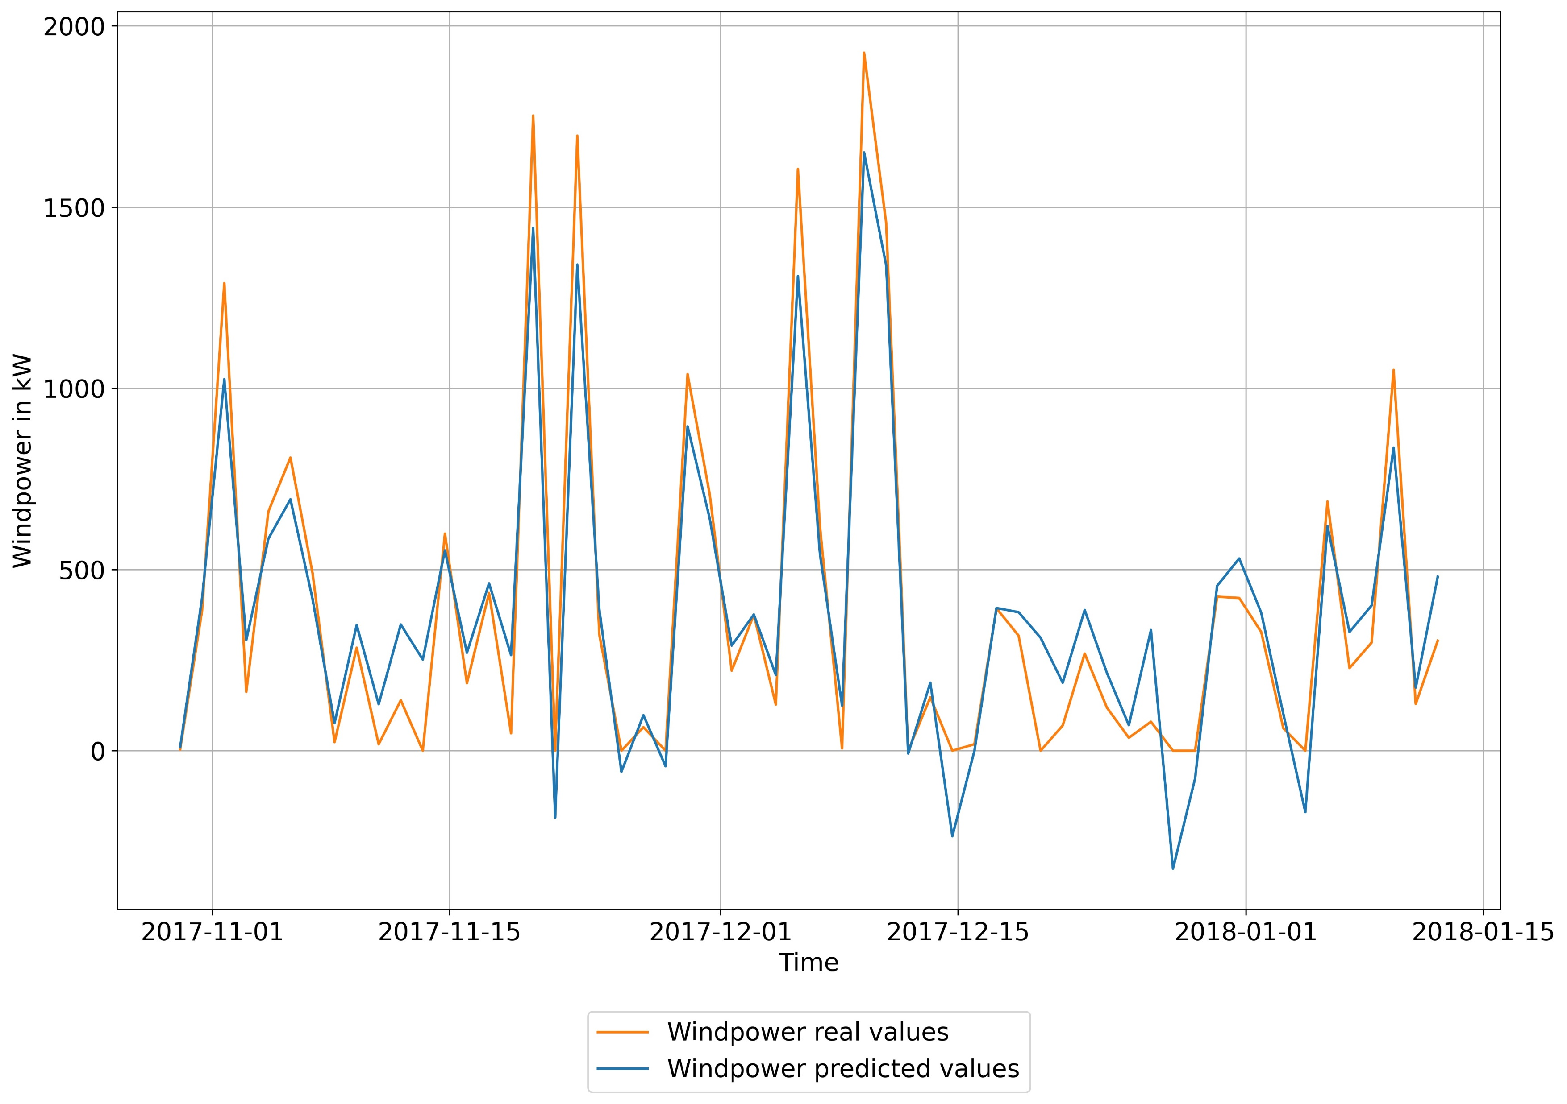
Multiple Linear Regression model

Slide 26
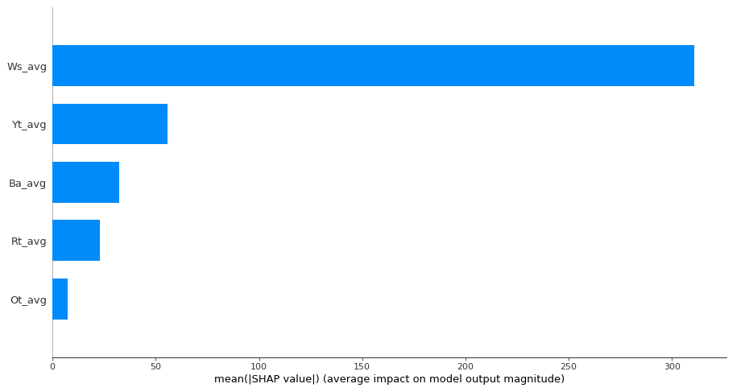

Slide 27
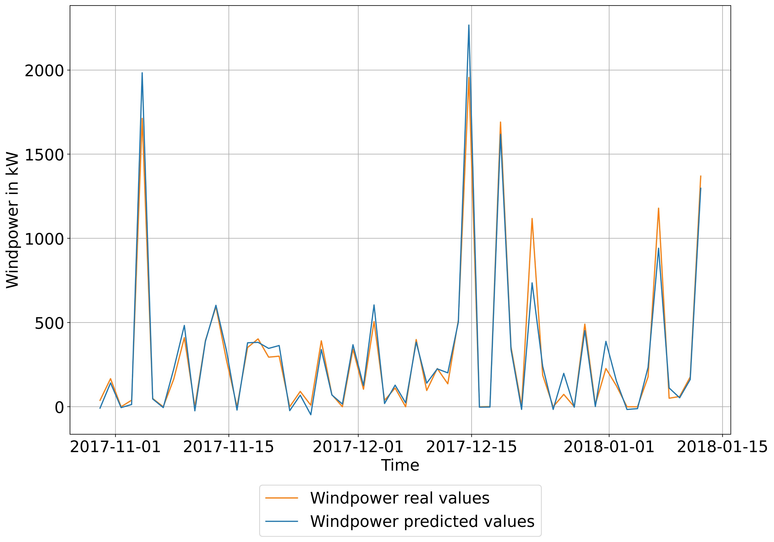
Support Vector Regression model

Slide 28
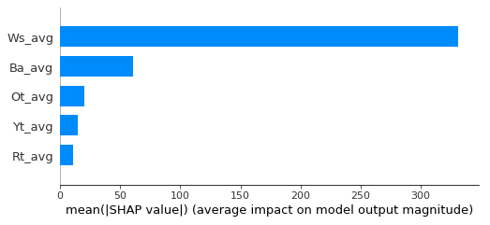
Support Vector Regression model

Slide 29
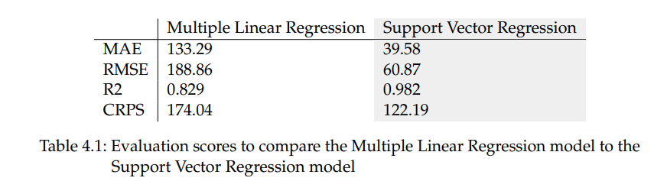
Comparison

Slide 30
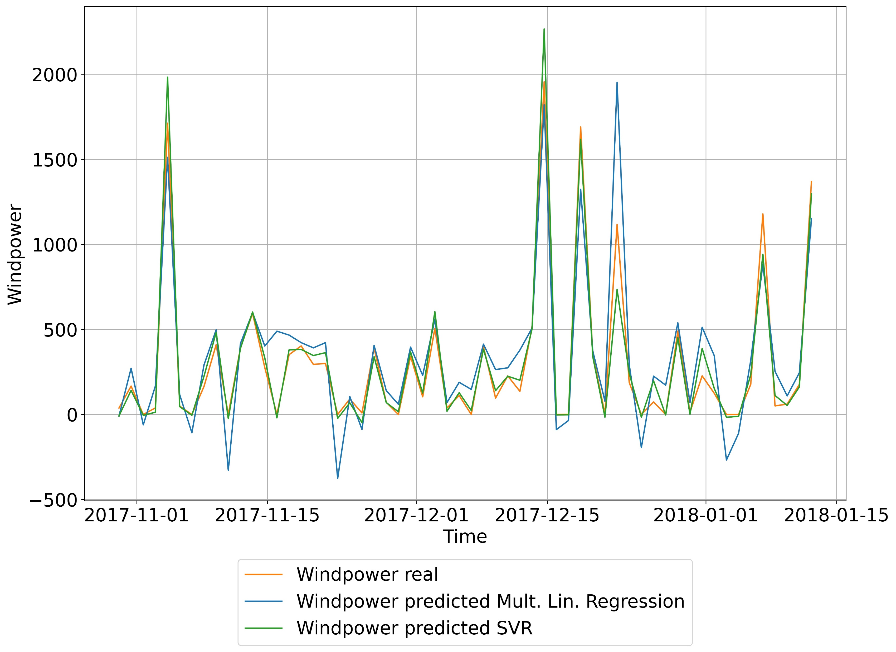
Comparison

Slide 31
05 Conclusion
- Conclusion
- Discussion

Slide 32

Conclusion
Main work
data processing
parameter selection
modeling a Multiple Linear Regression model
modeling a Support Vector Regression model
evaluating and comparing the different models

Slide 33
Conclusion
SVR approach works better for this particular wind farm dataset
I assume an SVR approach generally works better for wind power prediction than a Multiple Linear Regression approach

Slide 34

Discussion
Thank you so much for your interest and attention
Any questions?

